Slide 1
Chopras Web Extract - POC
Demonstrates the web crawling of the universities and scraping the data.

Slide 2
Objectives.
Understanding Scrapy Architecture & Framework.
Building holistic approach towards POC using Scrapy Framework.
Implement Scalable and Reusable Web Crawling Solution.
Building the logical Relational Data to Analytics Team.

Slide 3
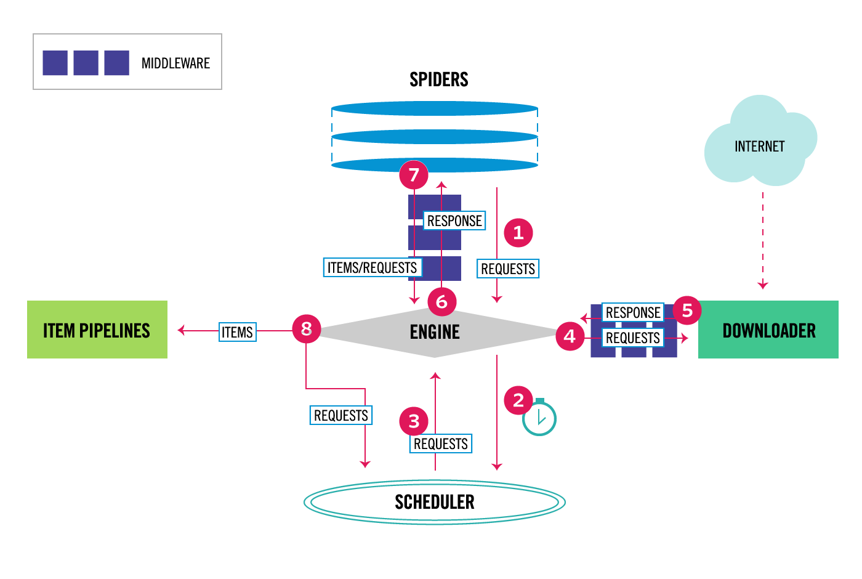
Scrapy Framework & Architecture
The ChoprasWebExtract use scrapy framework for crawling university sites.
Contd.

Slide 4
Scrapy Framework & Architecture
Scrapy is built on python language and its widely used framework for web scraping and crawling.
The Scrapy uses “Spiders”- The So Called BOT crawls the web page and extracts the data.
Spider uses Crawler Engine *( Which handles all in-flow & out-flow data and controls).
The crawler Engine Interacts with all the components of the framework.
Engine Schedules the Request
Engine redirect request to downloaders.
Engine redirects the response to Item Handlers. Etc
Contd.

Slide 5




ChoprasWebExtract Proposed Architecture
Internet
POC Hosting AWS VM
Scrapy Framework
Web Crawlers, bots, Scraper, Scheduler, Data Extractor, Data storage Spiders
POC CSV output for target data model
ETL Process For Data Mining, Data Transformation
MySQL/
PostgreSQL
Target Web Site Master Configuration DB
Web Page Database
Cloud Hosting
Contd.

Slide 6
ChoprasWebExtract Proposed Architecture
Page database
Analysis URLs
Get robots.txt
Collection of Target Master URLs
URL Analysis
Unprocessed URL Queue
Target Web Page Extract
Extract Links
Extract Required Content
Web Page Analysis module
Web Page Database
Data Mining, Data Transformation
Output as CSV file post validation
Internet

Slide 7
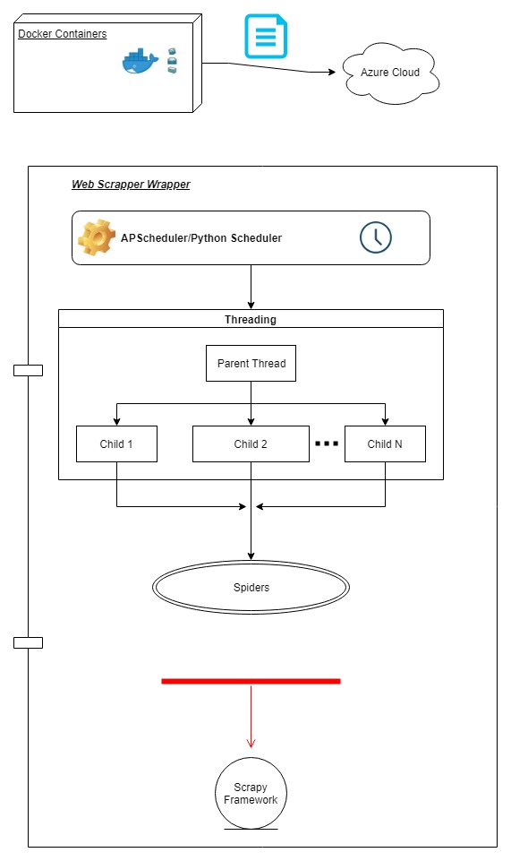
ChoprasWebExtract Implementation
Contd.

Slide 8
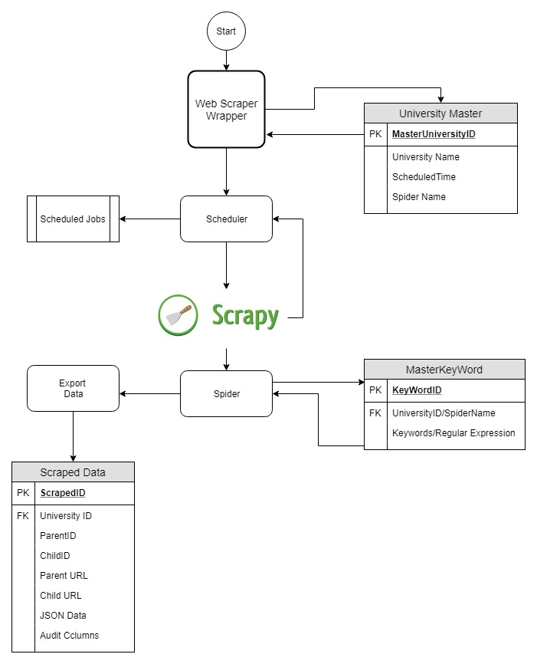
ChoprasWebExtract Implementation

Slide 9
Achieved Goals
Successfully able to implement proposed scheduling of the spiders using regular expression for the universities with master configuration.
Export the data to postgres database with relation readily available for Data Analysis.
Relational Mapping of Parent URL & Child URL with EAV design pattern.
Hosted the service in AWS using Containers provided by Dockers.

Slide 10
Challenges/Future Work
MultiThreading
Scrapy is single-threaded framework, we cannot use multiple threads within a spider at the same time. However, we can create multiple spiders and piplines at the same time to make the process concurrent.
Scrapy/Spider runs on Parent Thread using signals provided by asynchronous Twisted Framework which is an Asynchronous http protocol framework.
Research has to be made on running spiders with forking.
Distributed Containerization with Distributed Cloud
Analysis & Implementation has to be made on containerizing different components of ChoprasWebExtract Solution and achieve load balancing across distributed clouds using docker.
Middlewares
Analysis & Implementation has to be made on using middlewares provided by scrapy framework for handling redundant data while crawling.

Slide 11
References
Scrapy Framework
https://docs.scrapy.org/en/latest/
EAV Design Pattern: https://en.wikipedia.org/wiki/Entity%E2%80%93attribute%E2%80%93value_model
Dockers: https://docs.docker.com/develop/
Postgres: https://www.postgresql.org/docs/10/static/index.html

Slide 12
Repositories/Documentation
GitHub : https://github.com/guruprasannahegde/AutoCourseInfoExtract
Docker Images : You can “Search” from the Docker Hub website, or you can use the Docker command line tool to run the docker search command.
docker search autocourseinfoextract
Documents :
https://github.com/guruprasannahegde/AutoCourseInfoExtract/tree/master/Documents
https://media.readthedocs.org/pdf/scrapy/latest/scrapy.pdf

